Slide 1
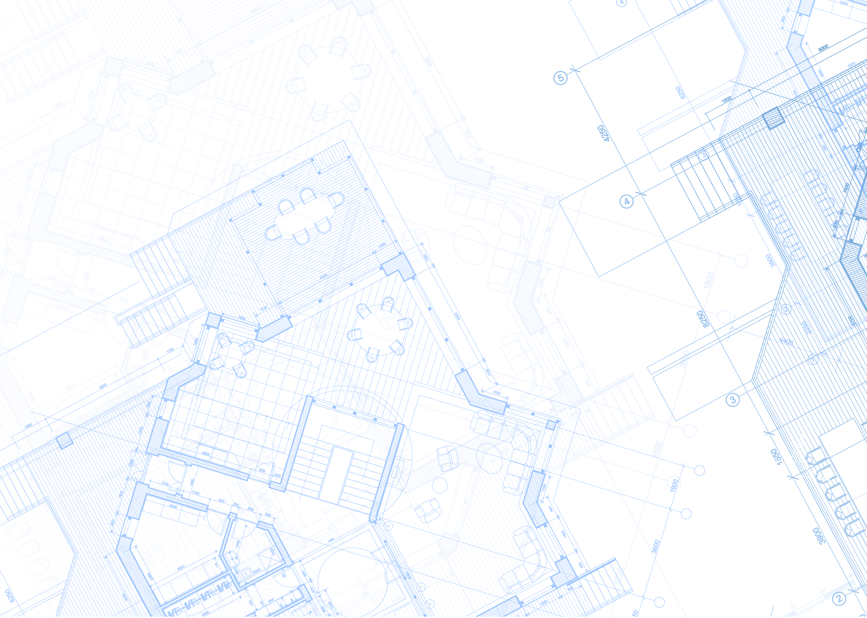

2025 San Diego Jewish
Community PULSE Survey
A post-October 7 Snapshot of
Jewish Communal Life in San Diego
Conducted by the Jewish Federation of San Diego

Slide 2
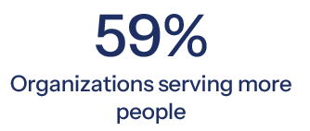
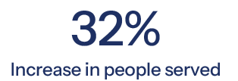
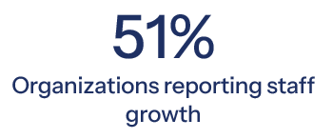
Context
Leaders of all San Diego Jewish organizations were invited
Perceptions post-Oct 7
39 Jewish organizations responded
  Synagogues/Chabads
  Schools
  Community Serving Organizations

Slide 3
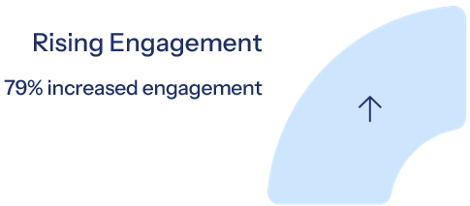
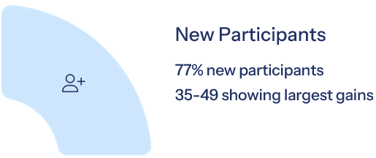
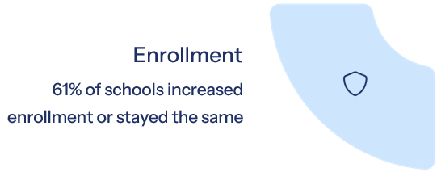

Section 1: Organizational Engagement

Slide 4
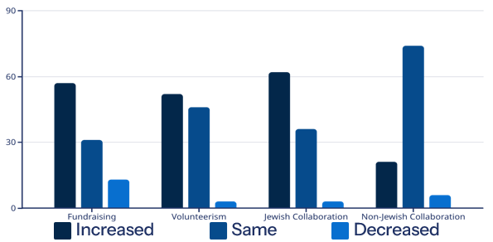
Section 2: Connection & Community
Jewish
Collaboration
Non-Jewish
Collaboration
Fundraising
Volunteerism
74%
Key Findings:
Increased fundraising and volunteerism
Increased collaboration Jewish organizations
62%
57%
52%
21%
Collaboration with non-Jewish organizations remained largely unchanged

Slide 5
Section 3: Safety and Wellbeing
Over $7 million spent on security in the past year!
Security Needs
88%
Budget Allocation
74%
(% of budget)
Budget Allocation
41% spend >10%
(% of budget)
Safety as Barrier
41% identify as a primary barrier
90% reported increased stress and mental health concerns
among constituents

Slide 6

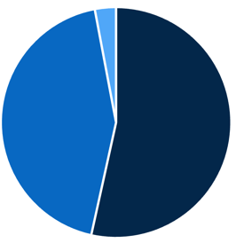


Section 4: Antisemitism and its Impact
Concerns about Antisemitism
Impact of Antisemitism:
  98% reported increased concern about antisemitism
  41% directly affected by incidents
  84% feel confident in their organization’s ability to respond to threats
3%
44%
54%

Slide 7



Section 5: Communicating about Israel
Frequency
Most organizations (26) communicated “as needed”
Messaging
Must navigate political sensitivities, emotional tensions and fatigue, and diversity of opinions
Response
82% report positive constituent responses to their Israel-related communications

Slide 8
Section 6: Use of Blueprint for Our Future
Yes, Extensively
21%
Connection and Engagement (25)
Jewish Identity and Belonging (22)
Security and Safety (17)
Connections to Israel (17)
Yes, Frequently
Yes, Infrequently
51%
Not at all
18%
Not familiar with the study
10%
“It shifted our mindset in terms of the importance of getting this information and how enlightening it can be.”

Slide 9
Section 6: Use of Blueprint for Our Future
www.SDJewishBlueprint.org

Slide 10
Section 7: Vision and Future Outlook
KEY CONCERNS
Assimilation, Declining Affiliation, Community Fragmentation
Cost of Living, Financial Barriers, Philanthropy
Antisemitism & Security
The data supports some concerns
  antisemitism, security, and high cost of living
Majority of organizations report increased collaboration, and
79% of organizations report an increase in engagement
Notes:
Erosion of Jewish identity, especially among younger generation.
Affordability of Jewish education, programming
Rising hate and its impact on Jewish visibility and engagement

Slide 11
Section 7: Vision and Future Outlook
Top Priorities (Next 3 Years)
Increasing Membership and Financial Stability
Youth and Family Programming
Community Engagement and Connection
Building Leadership and Volunteer Opportunities
Strengthening Jewish Identity and Education
Promoting Inclusivity (LGBTQ+, Interfaith)
“Family by family, person by person”

Slide 12
Conclusion
A Community United in Purpose
Safety Concerns
Rising Engagement
Resilient Identity
Collaborative Spirit
The San Diego Jewish community emerges as both
sobered and energized by recent events—
facing challenges with collective strength
and hope for the future

Slide 13
THANK YOU!
AIPAC
Aish San Diego
Camp Mountain Chai
Chabad of Downtown
Chabad of La Costa
Chabad of San Diego County
Chabad of University City
Chabad Youth Action Movement
Coastal Roots Farm
Congregation Beth Am
Congregation Beth El
Congregation Beth Israel
Congregation Dor Hadash
Friends of the Israel Defense Forces
Havurah Shir Ha Yam
Hillel of San Diego
IAC- Israeli American Council
Jewish Collaborative of San Diego
Jewish Community Foundation of San Diego
Jewish Family Service of San Diego
Jewish Federation of San Diego County
Jewish National Fund
Ken Jewish Community
Kindness Initiative
Kollel San Diego
Lawrence Family Jewish Community Center
Leichtag Foundation / The Hive
Ohr Shalom Synagogue
PeerK12
San Diego Hebrew Day
San Diego Jewish Academy
San Diego Jewish Experience
Seacrest Village Retirement Communities
Southern California Yeshiva High School
Temple Adat Shalom
Temple Beth Sholom
Temple Emanu-El
Temple Solel
Young Israel of San Diego

